Slide 1

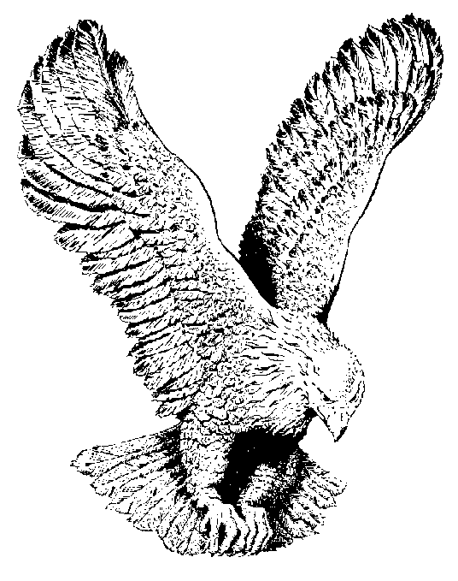
A MIGHTY FORTRESS
IS OUR GOD
A mighty fortress is our God,
A bulwark never failing;
Our helper He amid the flood
Of mortal ills prevailing.
For still our ancient foe
Doth seek to work us woe
His craft and power are great,
And, armed with cruel hate,
On earth is not his equal.

Slide 2
Did we in our own strength confide,
Our striving would be losing,
Were not the right Man on our side,
The Man of God’s own choosing
Dost ask who that may be?
Christ Jesus, it is He
Lord sabaoth is His name
From age to age the same
And He must win the battle.

Slide 3
And tho this world, with devils filled,
Should threaten to undo us,
We will not fear, for God hath willed
His truth to triumph thru us,
The Prince of darkness grim
We tremble not for him;
His rage we can endure,
For lo, his doom is sure
One little Word shall fell him.

Slide 4
That Word above all earthly powers-
No thanks to them abideth
The spirit and the gifts are ours
Thru Him who with us sideth.
Let goods and kindred go
This mortal life also,
The body they may kill,
God’s truth abideth still
His kingdom is forever.

